Slide 1

Exploring Stock Market Strategies with Risk and Influence using Complex Networks
Rachael Judy, Connor Klein, Josh Smith
Notes:
12 minute presentation

Slide 2
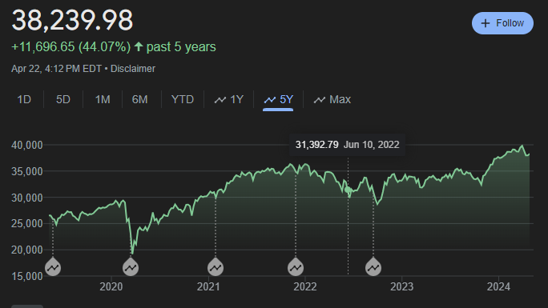
The Complex Systems of Economic Markets
Economic markets demonstrate many traits of complex systems.
Complex Features:
Volatility
Fat-tailed distributions
Interconnected entities and agents
Nonlinear and dynamic relationships
Self-organizing
These features have been explored in many fields such as psychology, economics, statistics, graph theory, and complex systems. Attempting to model the stock market with its facets of complex risk, interconnections between entities, and market strategies over time is a key area of research.
Notes:
1.5 minute
Background – markets show traits of complex systems
Volatility visible in the wild fluctuation of stock prices
Fat-tailed distributions in growth rates and stock returns and risk
Interconnections in terms of influence, partial information, shared investments, diffusion of information, correlation of stocks, etc
Nonlinear relationships (small changes in portfolios or behaviors) or choices at different times dynamic
Largely self organizing structure of brokers and stocks within constraints of legal regulation
Explored in many fields about risk, networks of stocks and brokers, looking for cliches in network of brokers and nodes, modeling crashes,
Presents an opportunity to explore the market and develop strategies based on the risk and interconnections in the network.
Our simulation could do many intervals, but we chose to focus on 2003-2013 for our simulations to capture what can be considered expected operation of the market but also look for antifragile strategy based on that risk and influence that can do better during drastic Black Swan events that Taleb discusses in his work
To do this, we designed a simulation to be run over various time intervals for interconnected brokers that can influence one another and with individually preferred risk levels

Slide 3
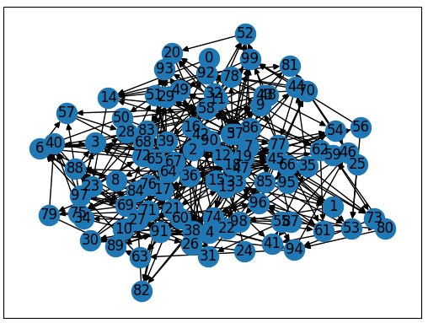
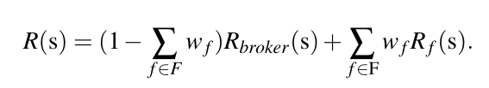

Key Elements: Influence
Directed path of influence for risk
$\#Friends \sim x^{−2.7}$
Risk with influence:
Notes:
2 minute
100 brokers, influence perceived risk, friends = input like connections in the field or copying high performing strategies they know; set up directionally (ie a broker might listen to an influencer but not bi directionally),
distributed number of inputs based on fat-tailed distribution with exponent 2.7 approximate in degree of a general directed social network
To populate the set of friends, the brokers were sampled randomly uniformly
Equation shows perceived risk for each broker which is a linear combination of the brokers assessment and the friends’ influence, each friend started with a set percent $w_i = .04$, total weight of neighbors limited to 0 to 1; connections strengthen if better, weakened if poorer
The agent’s goal = maintain perceived levels of risk within 10% of their desired risk level. For simplicity of interpretation, we gave each broker id a correlated level of risk. We also briefly explored achieving desired level and just holding the portfolio.
The way they would do this was look stocks available on a given day and perform their assessment of risk (changes by day) per eq. If too low, sell low risk and buy high risk. If too high, sell high risk, secondary priority of not keeping too much liquid money They would do this until hit daily limit or at desired level.
It is also important to demonstrate how we computed risk…

Slide 4
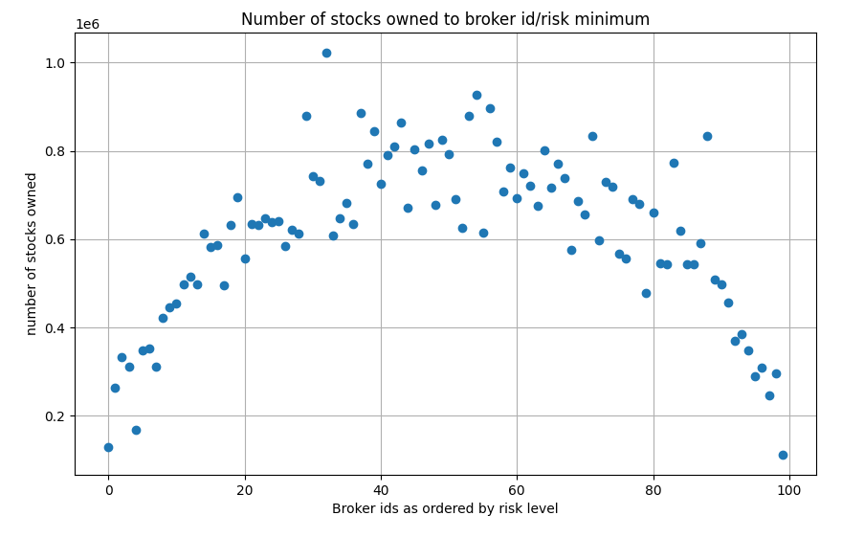
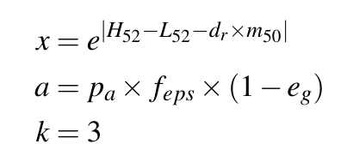
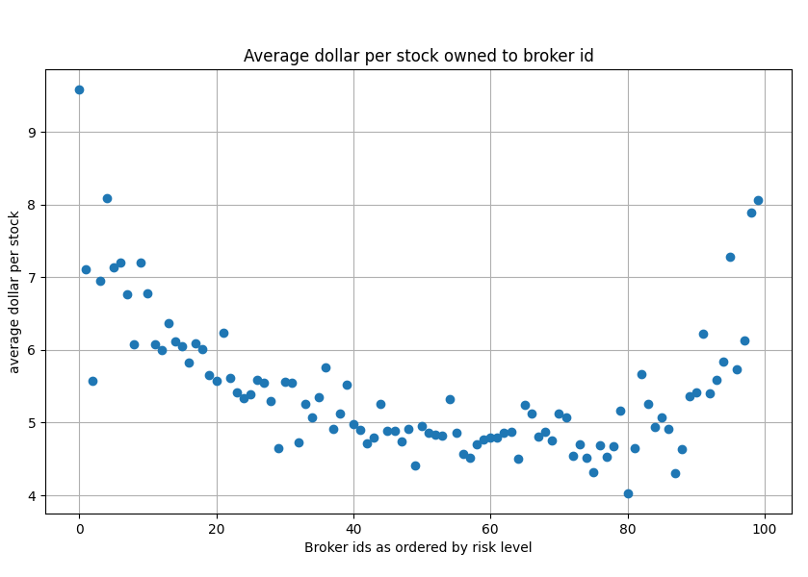

Key Elements: Risk
$R_{s}=ax^{−k}$
Portfolio risk represented as sum of individual risks multiplied by volume in portfolio
Notes:
3 minutes
NOTES FROM MINAI ON REPORT:
Justify why k=3 was chosen
We selected k = 3 because we believed there is an “average risk” of the stock, but not variance. and for k > a – 1, kth moment is infinite. Mean is the first moment and variance is the second. Therefore, k must be at least 2, 3 > a – 1 => a = 2, a larger study can be done if there is a better suited value for a, but we got good results with a = 2.
Explain more about why these parameters were chosen for the model; What is the source of this model, and what is its logic?
X – The goal of this value was to capture a positive value in the domain of 1 – infinity that represented the impact a stock may have. Impact meaning the vested amount or the worst case vs best case scenario. So to ensure the bounds, the base is an exponential function, this also helps with keeping our variance undefined. The exponent of this term was to capture voltality vs expected return. This was used to gauge just how unruly the stock behaves. We used an absolute value, as if the expected return was greater than the volatility, this was a safe stock, that may even return an infinitesimal risk.
Our expected return is the product of average of the stock price over 50 days times the dividend ratio. This is essentially the money in the bag. The volatlitiy is based on a year. We may be better able to capture . Impact = Volatility – Expected return.
Next we calculate the likelihood. The likelihood is trying to encapsulate the chances the stock becomes more volatile. This equation is the product of % share of equity of the stock , the expected earning per share and the complement of the quarterly growth. This number is complemented because all stocks are expected to have a positive quarterly growth, and a negative growth increases volatility.
What does impact mean here? How the stock may impact the portfolio/equity.
From Rachael: maybe note that this behavioral model of purchasing fewer stocks but more expensive ones at high risk emerged naturally and was not enforced
While we have a parameter that restricts risk to the total equity, this inspired the brokers to diversify in medium risk scenarios (which mirrors reality), and concentrate in stocks for high risk (reverse diversification)
the risk is represented by a fat-tailed distribution with an exponent of $k=3$ with $H_{52}$ as the 52-week high, $L_{52}$ as the 52-week low, $d_r$ as the dividend ratio, $m_{50}$ as the 50 day average, $e_g$ as the earnings growth, $f_{eps}$ as the forward earnings per share, and $p_a$ as the portfolio allocation of equity for the given stock.
A represents likelihood of risk with x as the potential impact of the stock, keeping in range 1, infinity
See plots showing how high risk brokers led to fewer total stocks but more expensive stocks, middle risk leads to more different stocks but less expensive average
Brokers are ordered by risk level from 0 to 10_000
Also note that risk adverse brokers often kept more of their assets liquid
Data collected was filtered to only those with the data necessary for this risk calculation

Slide 5
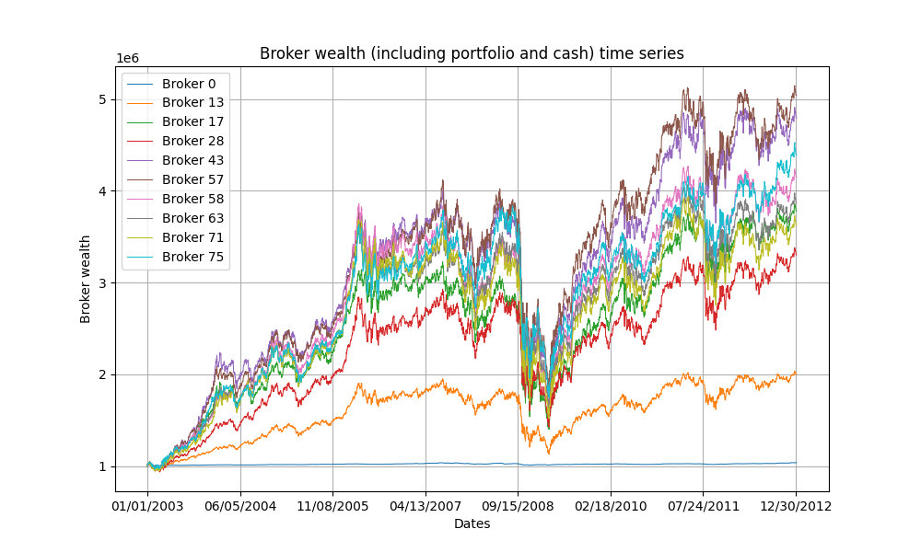
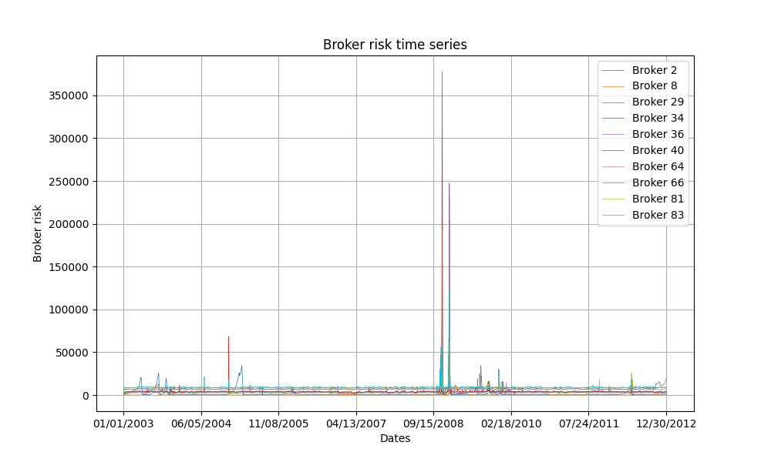
Results: Risk
Notes:
1.5 minutes
NOTES FROM MINAI’S COMMENTS:
- don’t say stop investing, say stop buying stocks
Example of portfolio behavior over time
Brokers follow the general market trends and grow over time.
Can see significant loss at 2007-2008, and spike in risk evaluations with plunging and rising market
the brokers, who did not cash out when the stocks crashed, rebounded after the crisis
By 2010, the typical brokers regained the wealth that they had acquired before 2008.
The high risk brokers can be seen to rebound more quickly and exceed their peers of medium risk in some cases. (see example of broker 80, broker 2, broker 20, broker 15
Further, it showed buying at the crash showed significant increase in portfolio value for brokers seeking medium and high levels of risk.
Note also stopping at fixed risk once the preferred risk level is reached and keeping portfolio does similarly to buying and selling to keep the risk

Slide 6
Results: Risk
Notes:
1.5 minutes
NOTES FROM MINAI’S COMMENTS:
- don’t say stop investing, say stop buying stocks
Example of portfolio behavior over time
Brokers follow the general market trends and grow over time.
Can see significant loss at 2007-2008, and spike in risk evaluations with plunging and rising market
the brokers, who did not cash out when the stocks crashed, rebounded after the crisis
By 2010, the typical brokers regained the wealth that they had acquired before 2008.
The high risk brokers can be seen to rebound more quickly and exceed their peers of medium risk in some cases. (see example of broker 80, broker 2, broker 20, broker 15
Further, it showed buying at the crash showed significant increase in portfolio value for brokers seeking medium and high levels of risk.
Note also stopping at fixed risk once the preferred risk level is reached and keeping portfolio does similarly to buying and selling to keep the risk

Slide 7
Results: Risk
Notes:
1.5 minutes
NOTES FROM MINAI’S COMMENTS:
- don’t say stop investing, say stop buying stocks
Example of portfolio behavior over time
Brokers follow the general market trends and grow over time.
Can see significant loss at 2007-2008, and spike in risk evaluations with plunging and rising market
the brokers, who did not cash out when the stocks crashed, rebounded after the crisis
By 2010, the typical brokers regained the wealth that they had acquired before 2008.
The high risk brokers can be seen to rebound more quickly and exceed their peers of medium risk in some cases. (see example of broker 80, broker 2, broker 20, broker 15
Further, it showed buying at the crash showed significant increase in portfolio value for brokers seeking medium and high levels of risk.
Note also stopping at fixed risk once the preferred risk level is reached and keeping portfolio does similarly to buying and selling to keep the risk

Slide 8
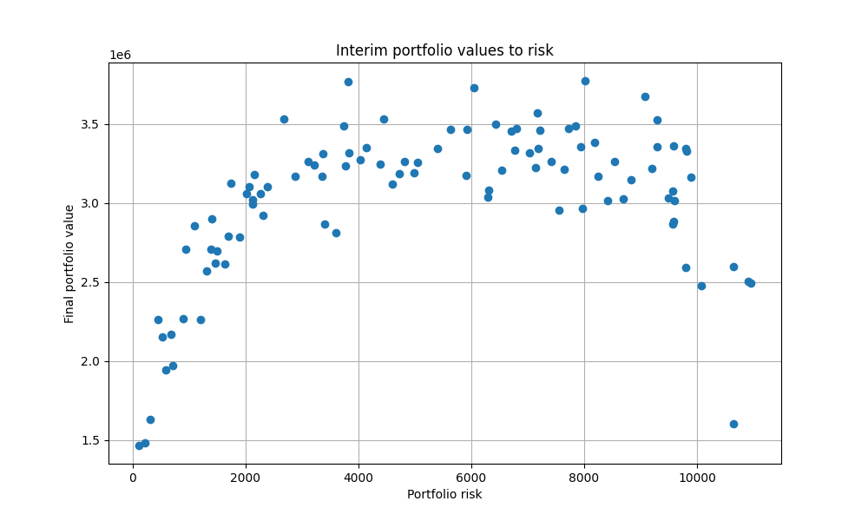
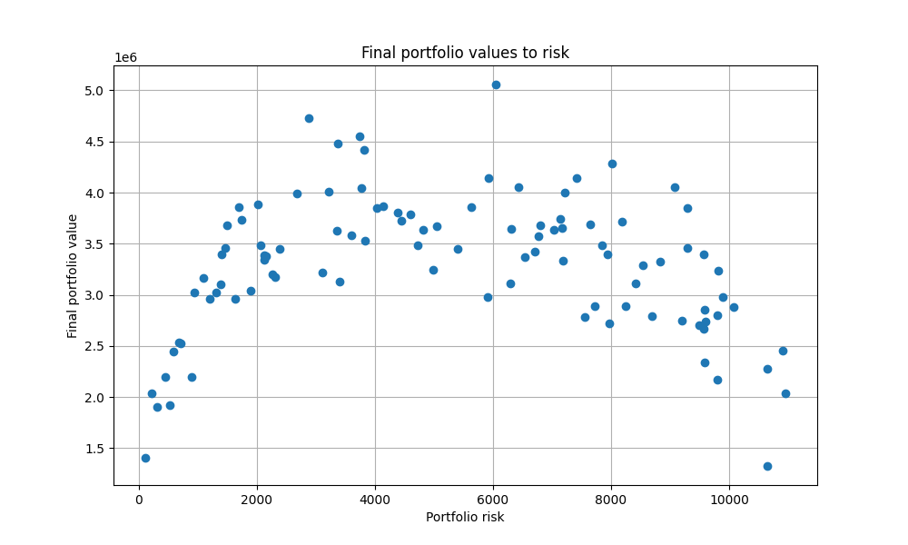
Antifragile Strategy
Notes:
1.5 minutes
Left figure show interim portfolio values before the 2007-2008 financial crisis
the brokers, who did not cash out when the stocks crashed, rebounded after the crisis
The high risk brokers can be seen to rebound more quickly and exceed their peers of medium risk in some cases.
Final values shows slightly different behavior; at event, risky brokers could make the most money but didn’t necessarily win over the large period of normal operation
by not exiting when their portfolios spiked, did not achieve the same levels of wealth as the more moderate brokers after the Black Swan event.
At the end, with our method of risk formulation, moderate risk brokers won overall

Slide 9
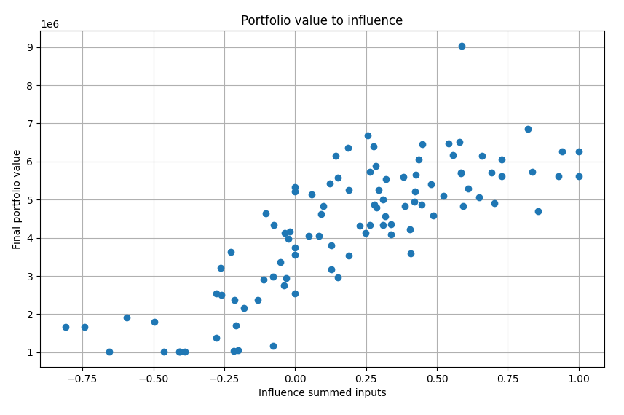
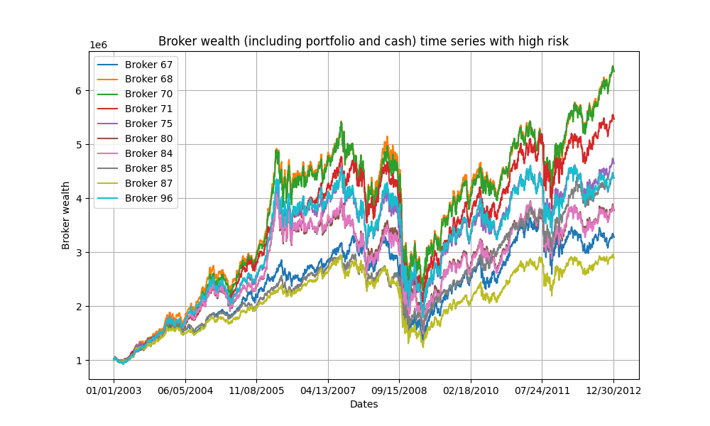
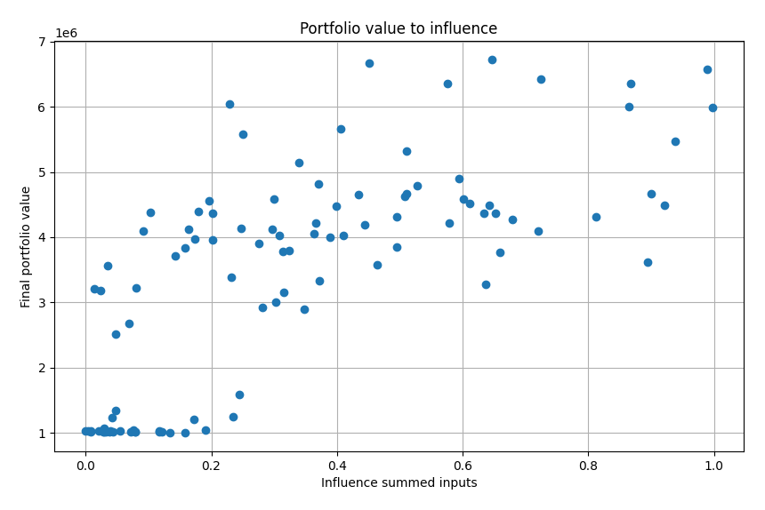
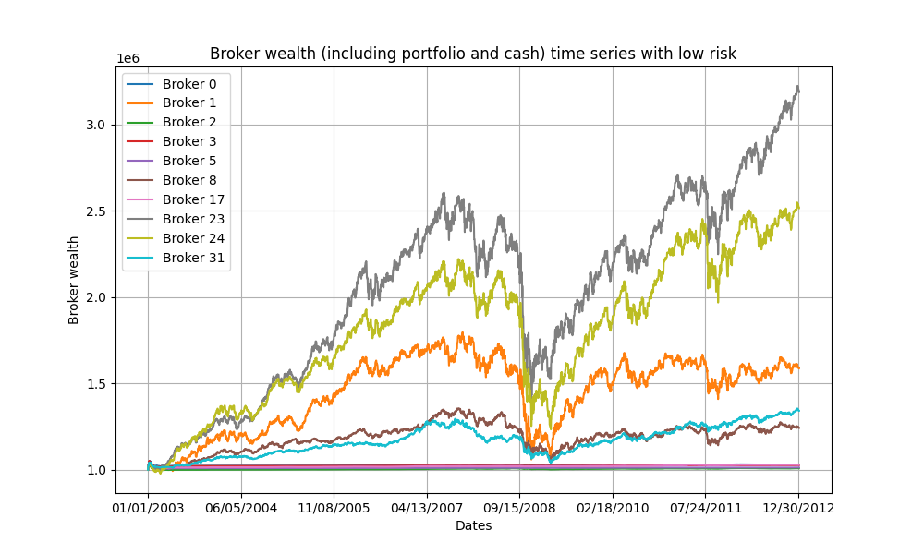
Results: Influence
Influence
Notes:
1.5 minute
Left side shows a couple of total influence to final portfolio value
Top left looked at having a negative influence but this didn’t exactly make sense with perceived risk calculation, further eval necessary
Even with the limitation of influence from 0 to 1, up to 50% of assessment provided by neighbor seemed to give increasing benefit
On right, see time series, high risk had more money as noted but influence still benefits across different levels
When assigning a 1/3 of brokers low, 1/3 med, 1/3 high and just adjusting influence, see a couple examples
Red and green in high risk do better than blue who took less input
Dark blue and orange doing much more poorly than mustard in
Basing the influence connections of the network around the risk assessment provides an expansion on a single broker's understanding of the stocks behavior to see higher ratio of good stocks but did not entirely capture the additional benefit of accessing partial information as desired.

Slide 10
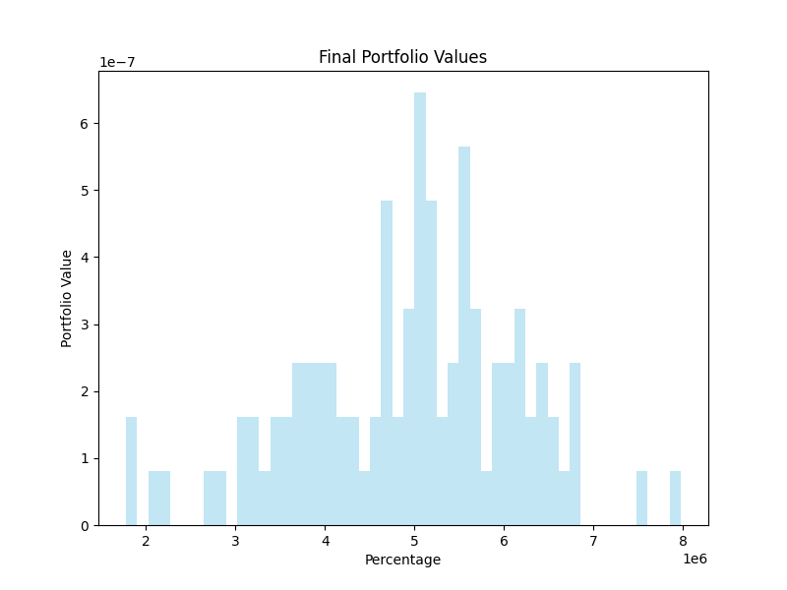
Challenges and Future Work
Influence did not account for partial information flow
Data filtration limits which stocks are used
Extend broker quantity and friend distribution
Expand risk evaluation for greater stock data
Explore and define the idea of negative influence
Make model more dynamic to actually adjust stock prices
Notes:
1.5 minutes
From this simulation, we achieved a better understanding of risk and influence but there were some limitations of our model to be explored later such as:
- Information flow mostly accounted for expansion of risk data but needs to be elaborated to better capture the idea of partial information
Data filtration cuts out stocks in which only partial information is available and stocks were removed from public market for private buyout or bankruptcy limiting types of stocks being considered – need to reference figure if keeping it to say the distribution isn’t entirely clear
Should expand to more brokers and possible make the connections more dynamic ie follow the best broker instead of being stuck entirely with initial connections
Could extend stock risk evaluation to better account for more relationships in stock statistics
Explore idea of negative influence in the market
Couldn’t actually affect stock prices – assumed small enough subset of actors to be able to use historical data
Add thesis statement
Address the graph

Slide 11
References
X. Gabaix, “Power laws in economics: an introduction,” \textit{Journal of Economic Perspectives}, vol. 30, no. 1, pp. 185–206, Feb. 2016.
N. N. Taleb, Antifragile: Things that gain from disorder. Harlow, England: Penguin Books, 2013.
D. Easley and J. Kleinberg, Networks, crowds, and markets: Reasoning about a highly connected world. Cambridge, England: Cambridge University Press, 2012.
C. Hommes, “Behavioral and Experimental Macroeconomics and Policy Analysis: A Complex Systems Approach,” Journal of Economic Literature, vol. 59, no. 1, pp. 149–219, Mar. 2021, doi: 10.1257/jel.20191434.
C. K. Tse, J. Liu, and F. C. M. Lau, “A network perspective of the stock market,” Journal of Empirical Finance, vol. 17, no. 4, pp. 659–667, Sep. 2010, doi: 10.1016/j.jempfin.2010.04.008.
M. Kuhlmann, "Explaining financial markets in terms of complex systems," \textit{Philosphy of Science}, vol. 81, no. 5, pp. 1117-1130, Dec. 2014. %doi: 10.1086/677699.
M. Di Maggio, F. Franzoni, A. Kermani, and C. Sommavilla, "The relevance of broker networks for information diffusion in the stock market," \textit{Journal of Financial Economics}, vol. 134, no. 2, pp. 419-446, Nov. 2019.
P. Gai and S. Kapadia, "Contagion in financial networks," \textit{Proceedings of the Royal Society}, vol. 466, no. 2120, pp. 2401–2423, Aug. 2010.
C. K. Tse, J. Liu, and F. C. M. Lau, “A network perspective of the stock market,” \textit{Journal of Empirical Finance}, vol. 17, no. 4, pp. 659–667, Sep. 2010. % doi: 10.1016/j.jempfin.2010.04.008.
G. Li, A. Zhang, Q. Zhang, D. Wu, and C. Zhan, “Pearson correlation coefficient-based performance enhancement of broad learning system for stock price prediction,” \textit{IEEE Transactions on Circuits and Systems II: Express Briefs}, vol. 69, no. 5, pp. 2413–2417, May 2022.
P. Fiedor, “Networks in financial markets based on the mutual information rate,” \textit{Physical Review E}, vol. 89, no. 5, May 2014. % doi: 10.1103/PhysRevE.89.052801.
I. Cooper and R. Priestley. "Real investment and risk dynamics," \textit{Journal of Financial Economics}, vol. 101, no. 1, pp. 182-205, July 2011.
K. J. Lansing and S. F. LeRoy, “Risk aversion, investor information and stock market volatility,” \textit{European Economic Review}, vol. 70, pp. 88-107, July 2014.
J. E. Corter and Y. J. Chen, “Do investment risk tolerance attitudes predict portfolio risk?,” \textit{Journal of Business and Psychology}, vol. 20, no. 3, pp. 369-381, 2006.
D. Harmon, B. Stacey, Y. Bar-Yam, and Y. Bar-Yam, "Networks of economic market interdependence and systemic risk," New England Complex Systems Institute, Cambridge, MA, Tech. Report 1011.3707, Mar. 2009.
Y. Y. Baydilli, S. Bayir, and I. Tuker, “A hierarchical view of a national stock market as a complex network,” \textit{Economic Computation \& Economic Cybernetics Studies \& Research}, vol. 51, no. 1, pp. 205–222, Jan. 2017.
Notes:
Here’s our references for the model

Slide 12
Questions?

